Slide 1
Search

Slide 2
Dynamic Web Proxy
Every time we create a web node we need to update our proxy cookbook. That doesn't feel right!
Update the wrapped proxy cookbook to dynamically use nodes with the web role

Slide 3
$ knife node show node1 -a cloud
node1:
cloud:
local_hostname: ip-10-198-51-26.us-west-1.compute.internal
local_ipv4: 10.198.51.26
private_ips: 10.198.51.26
provider: ec2
public_hostname: ec2-204-236-155-223.us-west-1.compute.amazonaws.com
public_ips: 204.236.155.223
public_ipv4: 204.236.155.223

Slide 4
$ knife node show node3 -a cloud
node3:
cloud:
local_hostname: ip-10-197-105-148.us-west-1.compute.internal
local_ipv4: 10.197.105.148
private_ips: 10.197.105.148
provider: ec2
public_hostname: ec2-54-176-64-173.us-west-1.compute.amazonaws.com
public_ips: 54.176.64.173
public_ipv4: 54.176.64.173

Slide 5
~/chef-repo/cookbooks/myhaproxy/default.rb
node.default['haproxy']['members'] = [{
"hostname" => "ec2-204-236-155-223.us-west-1.compute.amazonaws.com",
"ipaddress" => "ec2-204-236-155-223.us-west-1.compute.amazonaws.com",
"port" => 80,
"ssl_port" => 80
},
{
"hostname" => "ec2-54-176-64-173.us-west-1.compute.amazonaws.com",
"ipaddress" => "ec2-54-176-64-173.us-west-1.compute.amazonaws.com",
"port" => 80,
"ssl_port" => 80
}
]
include_recipe "haproxy::default"

Slide 6
~/chef-repo/cookbooks/myhaproxy/default.rb
all_web_nodes = search("node","role:web")
members = []
all_web_nodes.each do |web_node|
member = {
"hostname" => web_node["cloud"]["public_hostname"],
"ipaddress" => web_node["cloud"]["public_ipv4"],
"port" => 80,
"ssl_port" => 80
}
members.push(member)
end
node.default['haproxy']['members'] = members
include_recipe "haproxy::default"

Slide 7
Dynamic Web Proxy
Every time we create a web node we need to update our proxy cookbook. That doesn't feel right!
Update the wrapped proxy cookbook to dynamically use nodes with the web role

Slide 8
Upload the Cookbook
Update the minor versions of the proxy cookbook
Upload the proxy cookbook
Run chef-client on the proxy node
Verify that the proxy node relays requests to both web nodes

Slide 9
~/chef-repo/cookbooks/myhaproxy/metadata.rb
name 'myhaproxy'
maintainer 'The Authors'
maintainer_email 'you@example.com'
license 'all_rights'
description 'Installs/Configures myhaproxy'
long_description 'Installs/Configures myhaproxy'
version '0.3.0'
depends 'haproxy', '~> 1.6.6'

Slide 10
$ cd ~/chef-repo/cookbooks/myhaproxy

Slide 11
$ berks install
Resolving cookbook dependencies...
Fetching 'myhaproxy' from source at .
Fetching cookbook index from https://supermarket.chef.io...
Using build-essential (2.2.3)
Using haproxy (1.6.6)
Using myhaproxy (0.1.0) from source at .
Using cpu (0.2.0)

Slide 12
$ berks upload
Uploaded build-essential (2.2.3) to: 'https://api.opscode.com:443/organizations/vogue'
Uploaded cpu (0.2.0) to: 'https://api.opscode.com:443/organizations/vogue'
Uploaded haproxy (1.6.6) to: 'https://api.opscode.com:443/organizations/vogue'
Uploaded myhaproxy (0.3.0) to: 'https://api.opscode.com:443/organizations/vogue'

Slide 13
$ knife ssh "name:node2" -x USER -P PWD "sudo chef-client"
ec2-50-18-19-208.us-west-1.compute.amazonaws.com Starting Chef Client, version 12.3.0
ec2-50-18-19-208.us-west-1.compute.amazonaws.com resolving cookbooks for run list: ["myhaproxy"]
ec2-50-18-19-208.us-west-1.compute.amazonaws.com Synchronizing Cookbooks:
ec2-50-18-19-208.us-west-1.compute.amazonaws.com - cpu
ec2-50-18-19-208.us-west-1.compute.amazonaws.com - build-essential
ec2-50-18-19-208.us-west-1.compute.amazonaws.com - haproxy
ec2-50-18-19-208.us-west-1.compute.amazonaws.com - myhaproxy
ec2-50-18-19-208.us-west-1.compute.amazonaws.com Compiling Cookbooks...
ec2-50-18-19-208.us-west-1.compute.amazonaws.com Converging 9 resources
ec2-50-18-19-208.us-west-1.compute.amazonaws.com Recipe: haproxy::install_package
ec2-50-18-19-208.us-west-1.compute.amazonaws.com * apt_package[haproxy] action install (up to date)
ec2-50-18-19-208.us-west-1.compute.amazonaws.com * directory[/etc/haproxy] action create (up to date)
ec2-50-18-19-208.us-west-1.compute.amazonaws.com * template[/etc/init.d/haproxy] action create (up to date)
ec2-50-18-19-208.us-west-1.compute.amazonaws.com Recipe: haproxy::default
ec2-50-18-19-208.us-west-1.compute.amazonaws.com * cookbook_file[/etc/default/haproxy] action create (up to date)
ec2-50-18-19-208.us-west-1.compute.amazonaws.com * haproxy_lb[admin] action create (up to date)
ec2-50-18-19-208.us-west-1.compute.amazonaws.com * haproxy_lb[http] action create (up to date)
ec2-50-18-19-208.us-west-1.compute.amazonaws.com * haproxy_lb[servers-http] action create (up to date)
ec2-50-18-19-208.us-west-1.compute.amazonaws.com * template[/etc/haproxy/haproxy.cfg] action create
ec2-50-18-19-208.us-west-1.compute.amazonaws.com - update content in file /etc/haproxy/haproxy.cfg from 1054d8 to 6002e2
ec2-50-18-19-208.us-west-1.compute.amazonaws.com --- /etc/haproxy/haproxy.cfg 2015-05-16 00:59:12.776804000 +0000
ec2-50-18-19-208.us-west-1.compute.amazonaws.com +++ /tmp/chef-rendered-template20150516-11674-nm31wt 2015-05-16 01:05:20.036804000 +0000
ec2-50-18-19-208.us-west-1.compute.amazonaws.com @@ -35,8 +35,8 @@
ec2-50-18-19-208.us-west-1.compute.amazonaws.com
ec2-50-18-19-208.us-west-1.compute.amazonaws.com
ec2-50-18-19-208.us-west-1.compute.amazonaws.com backend servers-http
ec2-50-18-19-208.us-west-1.compute.amazonaws.com - server ec2-54-176-64-173.us-west-1.compute.amazonaws.com 54.176.64.173:8080 weight 1 maxconn 100 check
ec2-50-18-19-208.us-west-1.compute.amazonaws.com - server ec2-204-236-155-223.us-west-1.compute.amazonaws.com 204.236.155.223:8080 weight 1 maxconn 100 check
ec2-50-18-19-208.us-west-1.compute.amazonaws.com + server ec2-54-176-64-173.us-west-1.compute.amazonaws.com 54.176.64.173:80 weight 1 maxconn 100 check
ec2-50-18-19-208.us-west-1.compute.amazonaws.com + server ec2-204-236-155-223.us-west-1.compute.amazonaws.com 204.236.155.223:80 weight 1 maxconn 100 check
ec2-50-18-19-208.us-west-1.compute.amazonaws.com
ec2-50-18-19-208.us-west-1.compute.amazonaws.com
ec2-50-18-19-208.us-west-1.compute.amazonaws.com * service[haproxy] action enable (up to date)
ec2-50-18-19-208.us-west-1.compute.amazonaws.com * service[haproxy] action start (up to date)
ec2-50-18-19-208.us-west-1.compute.amazonaws.com * service[haproxy] action reload
ec2-50-18-19-208.us-west-1.compute.amazonaws.com - reload service service[haproxy]
ec2-50-18-19-208.us-west-1.compute.amazonaws.com
ec2-50-18-19-208.us-west-1.compute.amazonaws.com Running handlers:
ec2-50-18-19-208.us-west-1.compute.amazonaws.com Running handlers complete
ec2-50-18-19-208.us-west-1.compute.amazonaws.com Chef Client finished, 2/11 resources updated in 11.256445934 seconds

Slide 14
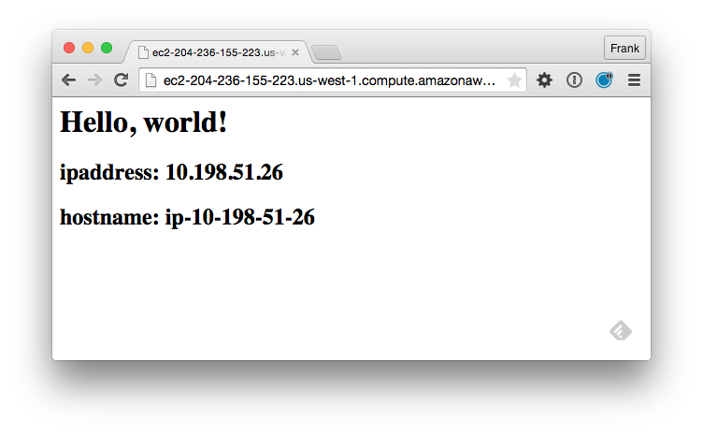

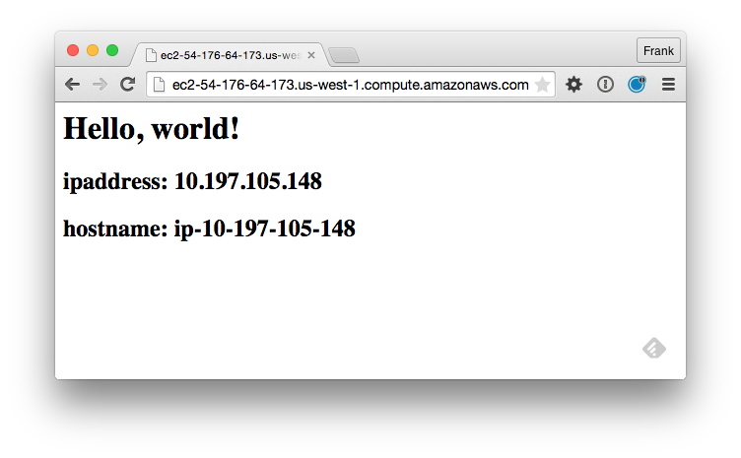

Slide 15


Slide 16
Discussion
What questions can we help you answer?

